Slide 1
Kernel Synchronisation Methods

Slide 2
Causes of Concurrency
Interrupts— An interrupt can occur asynchronously at almost any time, interrupting the currently executing code.
Softirqs and tasklets— The kernel can raise or schedule a softirq or tasklet at almost any time, interrupting the currently executing code.
Kernel preemption— Because the kernel is preemptive, one task in the kernel can preempt another.
Sleeping and synchronization with user-space— A task in the kernel can sleep and thus invoke the scheduler, resulting in the running of a new process.
Symmetrical multiprocessing— Two or more processors can execute kernel code at exactly the same time.

Slide 3
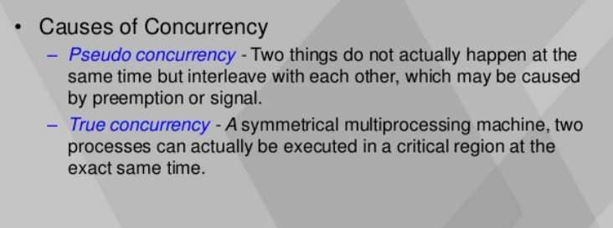
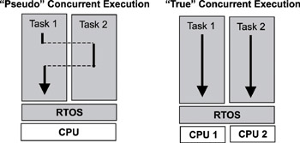
True Vs Pseudo concurrency

Slide 4
Atomic Operations
Interrupts can occur between instructions.
If an interrupt occurs while instructions are being executed, the partially computed instruction is flushed.
Therefore, any operation that can be executed using only one instruction is safe from interrupts
Such operations are called atomic.
Linux provides a set of operations that guarantee atomic operations on a variable. These operations can be used to avoid simple race conditions.

Slide 5
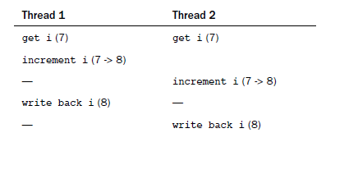
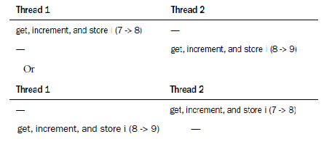
Recall the problem we discussed
With Atomic operation

Slide 6
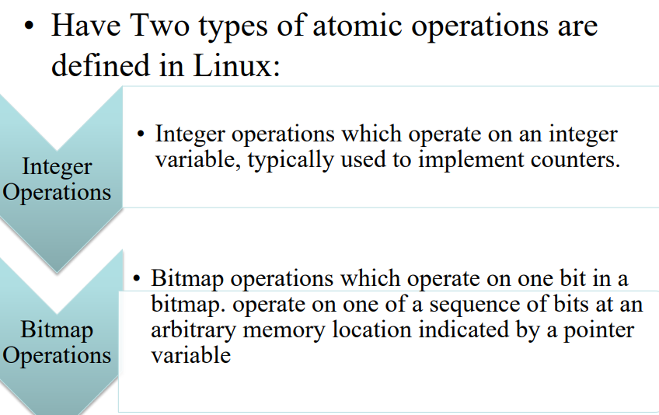

Slide 7
atomic_t
Atomic integer methods operate on a special data type called atomic_t.
Adv:
Ensures that the atomic operations are used only with these special types.
Ensures that data types are not passed to any non-atomic functions.
Ensure compiler does not optimize access to the value.
Hides architecture specific differences in its implementation.

Slide 8
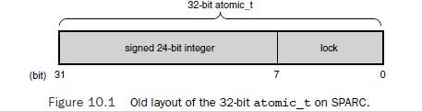
Defined in <linux/types.h>
Typedef struct
{
Volatile int counter;
}atomic_t;
In older SPARC machines only 24 bits were used, now it is changed and all 32 bits can be used.

Slide 9
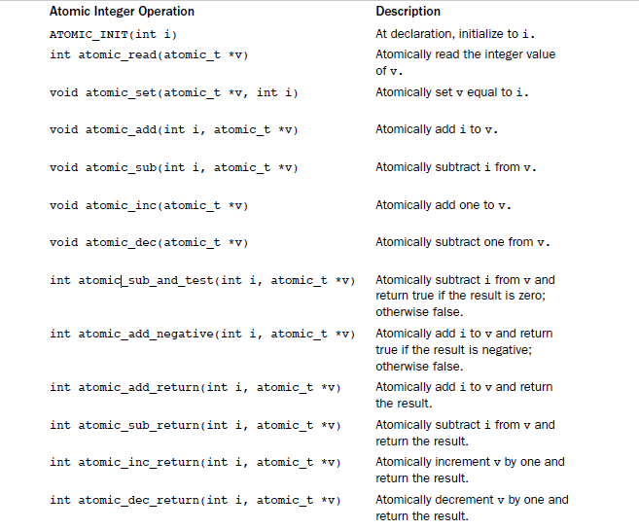

Slide 10
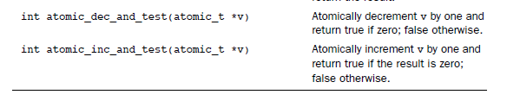

Slide 11
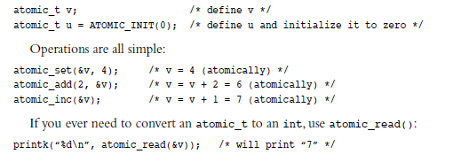
Example

Slide 12
Atomic vs ordering
Atomicity ensures that the instruction occur without interruption and that they complete either in their entirety or not at all
Eg: if an integer is initially 42 and then set to 365, a read on the integer always returns 42 or 365 and never in between.
Ordering ensures that the desired, relative ordering of two or more instructions, even it they are to occur in separate threads of execution or even separate processors is preserved.
Eg: read always occur before all pending writes.
Ordering is enforced via barrier operations.

Slide 13
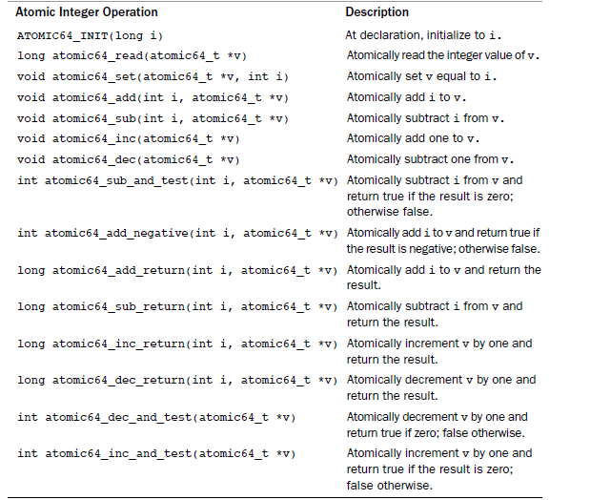
64 bit atomic operations

Slide 14
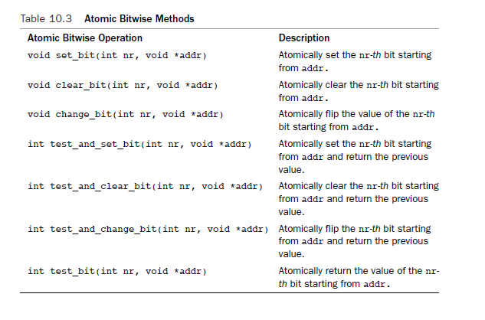
Atomic bitwise operations

Slide 15
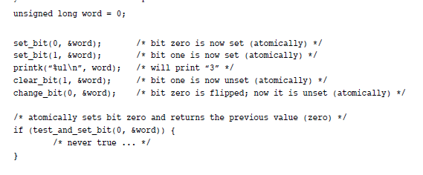
Example

Slide 16
Spinlocks
In real life, critical region can span multiple functions. In such complex scenario, a more general method of synchronisation is needed: Lock
The most common lock in the Linux kernel is the spin lock.
A spin lock is a lock that can be held by at most once thread of execution.
If a thread of execution attempts to acquire a spin lock while it is already held, which is called contended, the thread busy loops – spins.

Slide 17
Note:
Spin lock cannot be acquired recursively – it would deadlock on the second call to lock.
- A process holding a spinlock may not be pre-empted , or else a deadlock situation could occur.

Slide 18
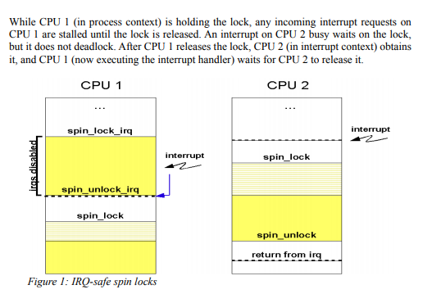
A critical section in process context is guarded by spin_lock_irq and spin_unlock_irq (disable all interrupts on the local CPU for the critical section).
In interrupt handlers its normal spin_lock and spin_unlock.

Slide 19
Spin Locks
Linux kernel’s spin locks are non-recursive
Spin locks can be used in interrupt handlers, whereas semaphores cannot be used because they can sleep.
If a lock is used in an interrupt handler, you must also disable local interrupts (interrupts on current processor) before obtaining the lock.
Disable kernel preemption
DEFINE_SPINLOCK(mr_lock)
Spin_lock(&mr_lock);
/*Critical Section/*
Spin_unlock(&mr_lock);
Spin Locks Are Not Recursive!
Unlike spin lock implementations in other operating systems and threading libraries, the
Linux kernel’s spin locks are not recursive. This means that if you attempt to acquire a lock
you already hold, you will spin, waiting for yourself to release the lock. But because you are
busy spinning, you will never release the lock and you will deadlock. Be careful!

Slide 20
Disable kernel preemption and disable interrupts
DEFINE_SPINLOC(mr_lock)
Unsigned long flags;
Spin_lock_irqsave(&mr_lock,flags);
/*Critical Section*/
Spin_unlock_irqrestore(&mr_lock,flags);

Slide 21
Not recommended
If you know that interrupts are enabled and no need to restore to previous state.
DEFINE_SPINLOCK(mr_lock);
Unsigned long flags;
Spin_lock_irq(&mr_lock);
/*critical section*/
spin_unlock_irq(&mr_lock);

Slide 22
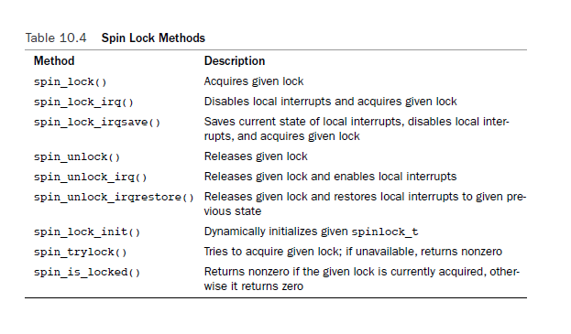
Other Spinlock methods

Slide 23
Spinlocks and Bottom Halves
Because bottom half might preempt process context code, if data is shared between a bottom-half and process context, you must protect the data in process context with both a lock and then disabling of bottom halves.
spin_lock_bh()
Spin_unlock_bh()
Two tasklets of same type do not ever run simultaneously. Thus, there is no need to protect data used only within a single type of tasklet.
A normal spinlock will work.
Softirqs can run simultaneously on multiple CPUs but one softirq will not preempt another softirq running on same processor. Hence lock is required but disabling bottom half is not required.

Slide 24
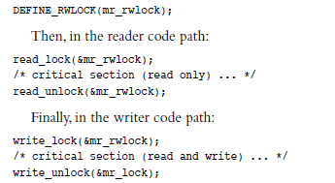
Reader-Writer Spinlocks
One or more readers can concurrently hold the reader lock. The writer lock, conversely, can be held by at most one writer with no concurrent readers.
Linux reader-writer spin locks favor readers over writers.

Slide 25
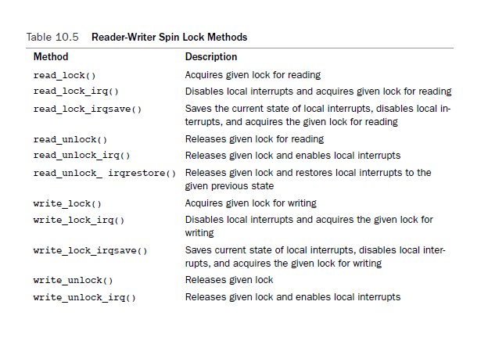
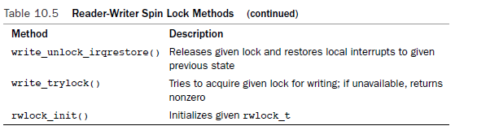
Also called shared/exclusive or concurrent/exclusive locks.

Slide 26
Semaphores
Its sleeping locks in Linux
When a task attempts to acquire a semaphore that is unavailable, the semaphore places the task onto a wait queue and puts the task to sleep. The processor is then free to execute other code.
Unlike the spin locks, semaphores do not disable the kernel preemption and consequently, code holding a semaphore can be preempted. This means semaphores do not adversely affect scheduling latency.

Slide 27
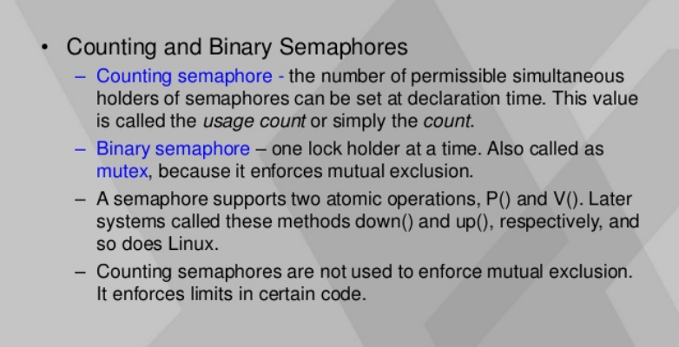

Slide 28
Creating and Initializing Semaphores
Struct semaphore name;
Sema_init(&name, count);
To create mutex:
Static DECLATE_MUTEX(name);
If(down_interruptible(&mr_sem) {
…..
}
/*Critical Section*/
up(&mr_sem);

Slide 29
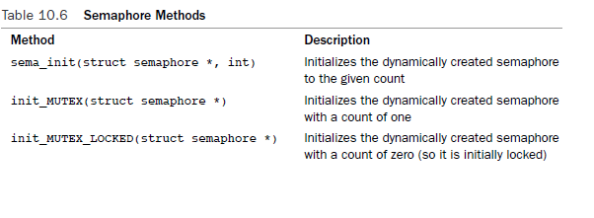
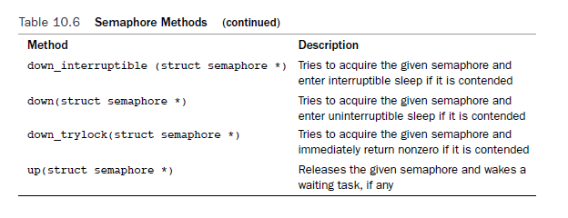

Slide 30
Reader-Writer Semaphores
All reader-writer semaphores are mutexes – that is, their usage count is one – although they enforce mutual exclusion only for writers, not readers.
Reader-writer semaphores have a unique method that their reader-writer spin lock cousins do not have:
downgrade_write(): This function atomically converts an acquired write lock to a read lock.
It is worthwhile using only if your code naturally spits along reader/writer boundary.

Slide 31
Mutexes
It behaves similar to a semaphore with a count of one, but it has a simpler interface, more efficient performance and additional constraints on its use.
- only one task can hold the mutex at a time. That is, usage count on a mutex is always one.
Whoever locked the mutex must unlock
Recursive locks and unlocks are not allowed. That is, you cannot recursively acquire the same mutex, and you cannot unlock an unlocked mutex.
A process cannot exit while holding a mutex.
A mutex cannot be acquired by an interrupt handler or bottom half, even with mutex_trylock()

Slide 32
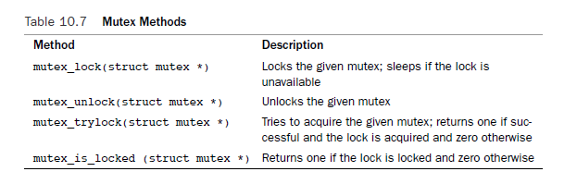
Mutex Locks

Slide 33
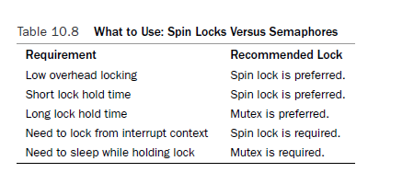
Spinlock Vs Semaphores

Slide 34
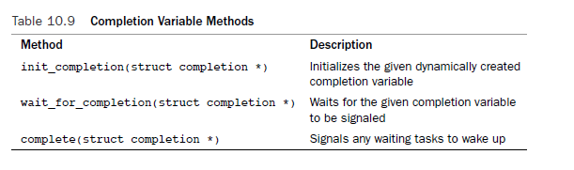
Completion Variables
Its similar to Semaphore but an easy way to synchronise between two tasks in the kernel when one task needs to signal to the other that the event has occurred. E.g. vfork()

Slide 35
BKL: Big Kernel Lock
A global spin lock that was created to ease the transition from Linux’s original SMP implementation to fine-grained locking.
BKL Properties:
Sleep is allowed while holding the BKL. The lock is automatically dropped when the task is unscheduled and reacquired when the task is rescheduled.
The BKL is a recursive lock
BKL only can be used in process context.
New users of the BKL are forbidden.

Slide 36
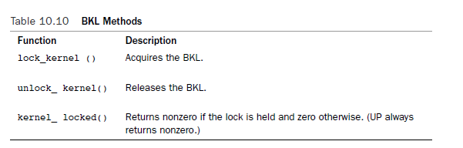

Slide 37
References
Images from various Internet sources

